Slide 1
Data Analytics and

Slide 2
Data Analytics vs Data Analysis
Data Analysis
Data analysis is a procedure of investigating, cleaning, transforming, and training of the data with the aim of finding some useful information
Open Refine, Tableau public, KNIME, Google Fusion Tables, Node XL and many more
Data Analytics
Analytics is utilizing data, machine learning, statistical analysis and computer-based models to get better insight and make better decisions from the data. Analytics is defined as “a process of transforming data into actions through analysis and insight in the context of organizational decision making and problem-solving.”
Microsoft Excel, SAS, R, Python(libraries), tableau public, Apache Spark

Slide 3





Steps to prepare data for data analysis
Prepare Data
Model the Data
Visualize the Data
Analyze the Data
Deploy & Maintain Deliverables

Slide 4
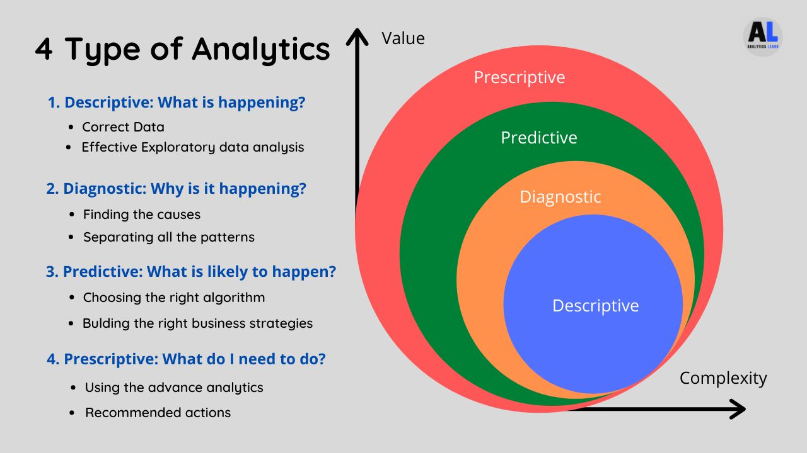
Types of Data Analytics

Slide 5
Who is Database Analyst?
Database analysts
Database analysts ensure that the storage, availability and coherence of electronically stored data meet an organization's needs. Their job tasks are similar to those performed by database administrators.
These tasks include
Maintaining databases
Updating software permissions as needed,
Modifying database structures
Backing up stored data.

Slide 6
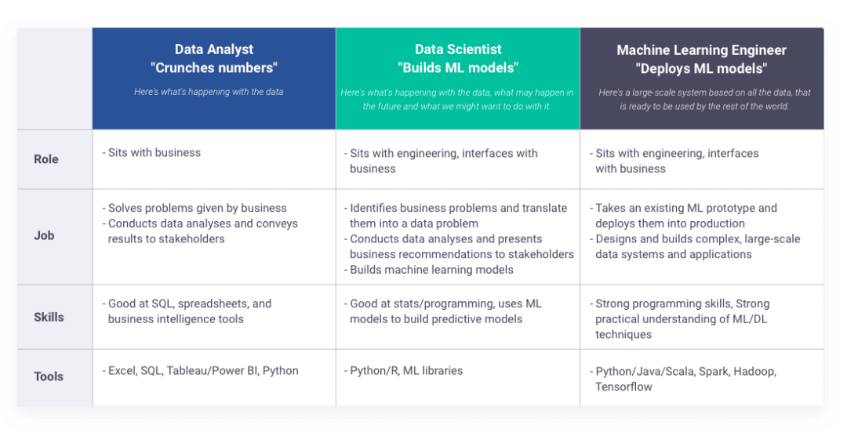

Slide 7
DATA WAREHOUSING

Slide 8
What is Data Warehousing?
Data Warehousing concepts:
OLAP (On-Line Analytical Processing)
Types Of OLAP Cubes
Dimensions, Facts & Measures
Schemas

Slide 9
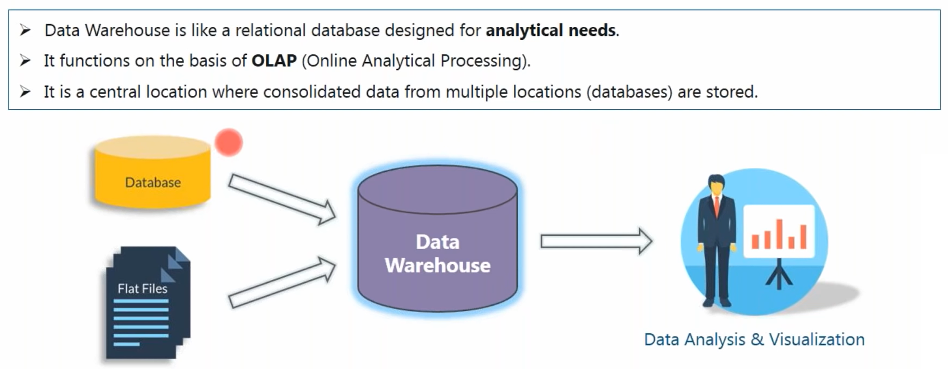
What is Data Warehouse?

Slide 10
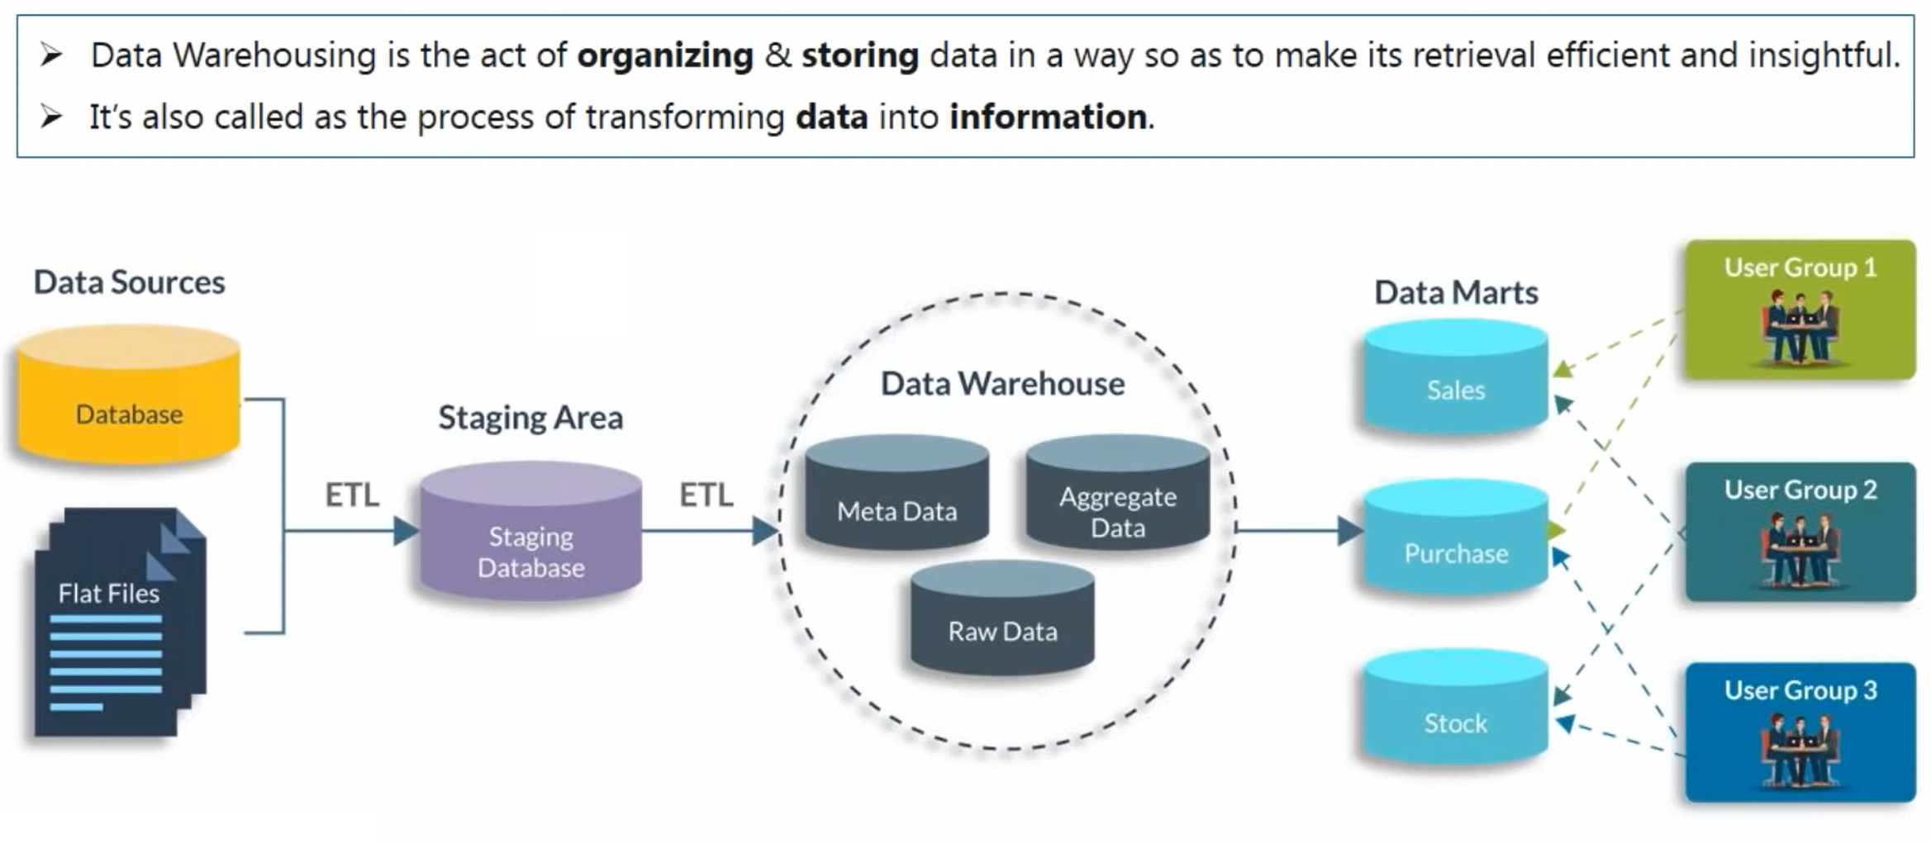
What is Data Warehousing?

Slide 11
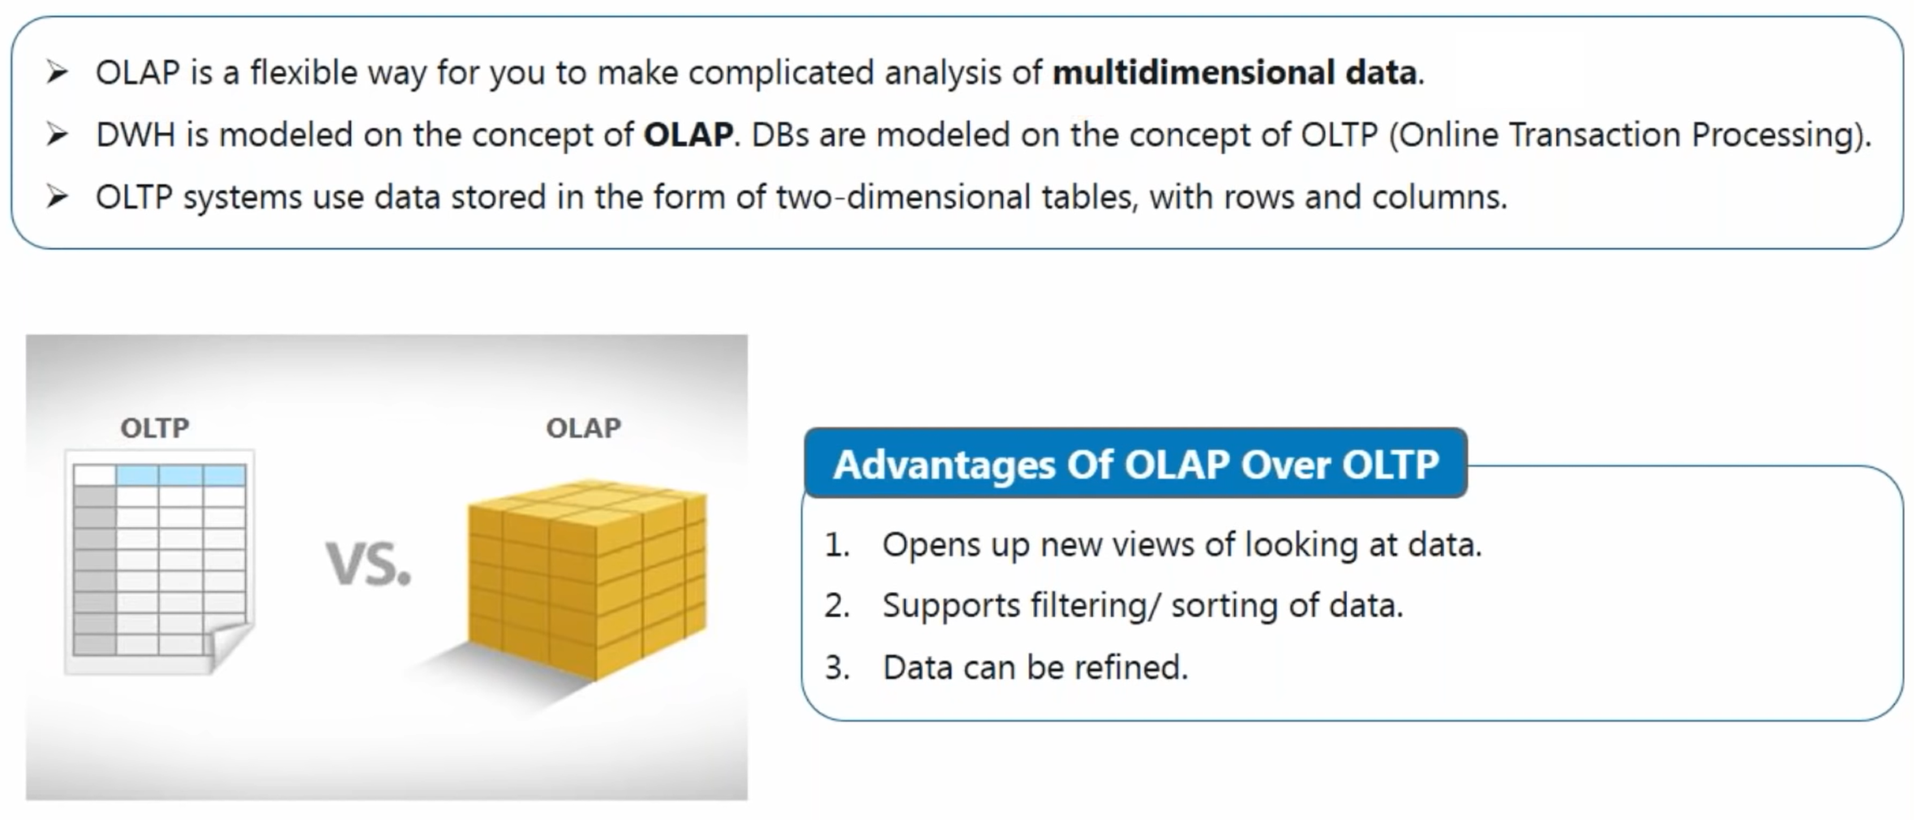
Online Analytics Processing

Slide 12
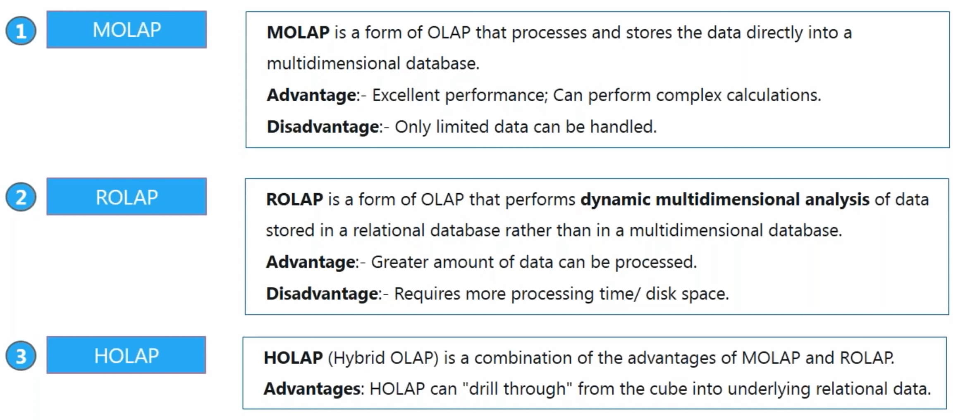
Types of OLAP Cubes!

Slide 13
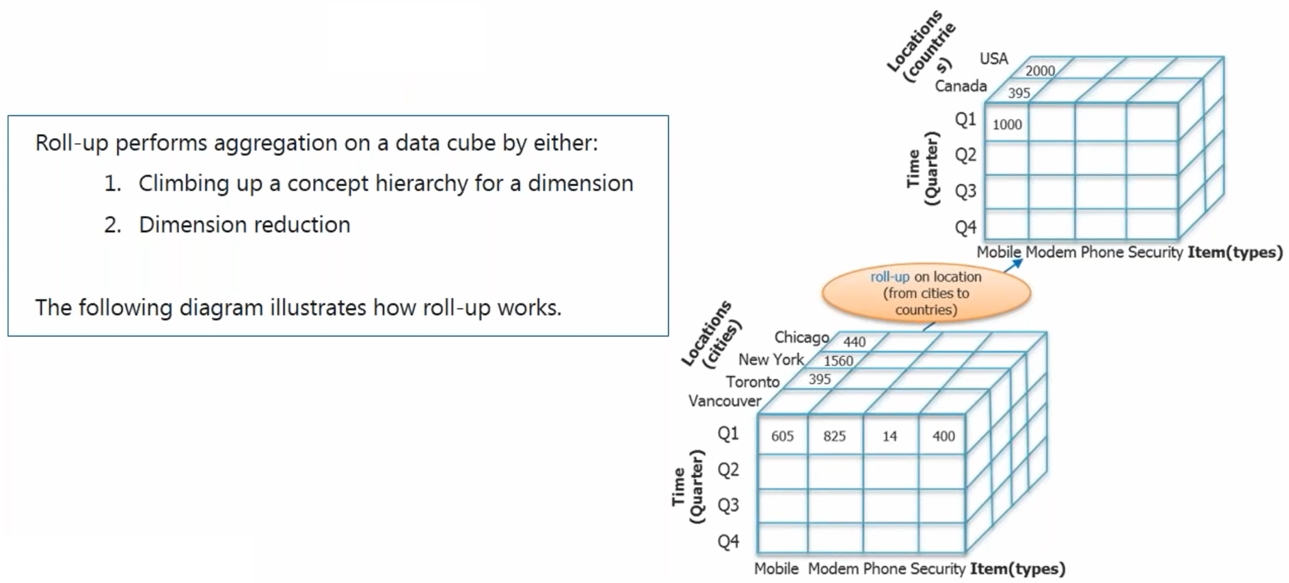
OLAP Operations– Roll UP

Slide 14
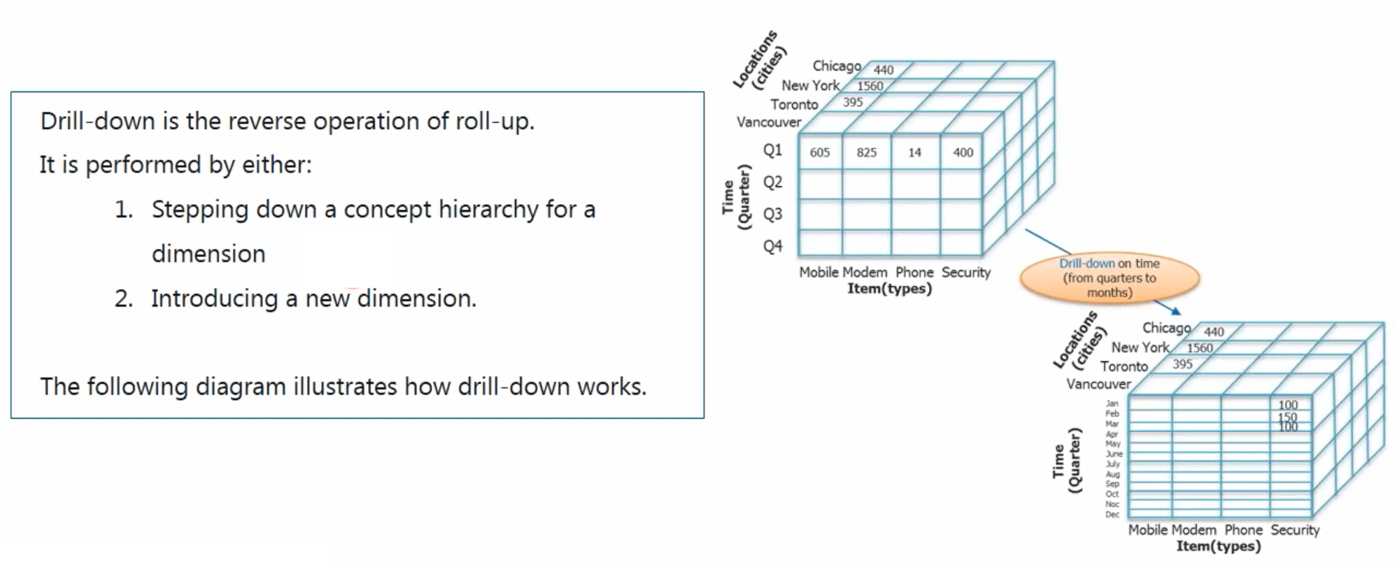
OLAP Operations– Drill Down

Slide 15
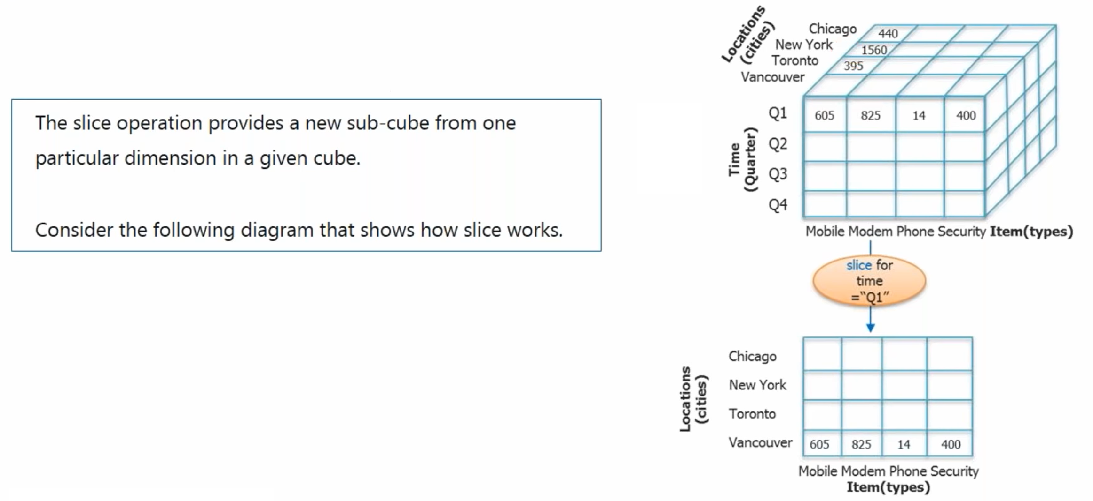
OLAP Operations– Slice

Slide 16
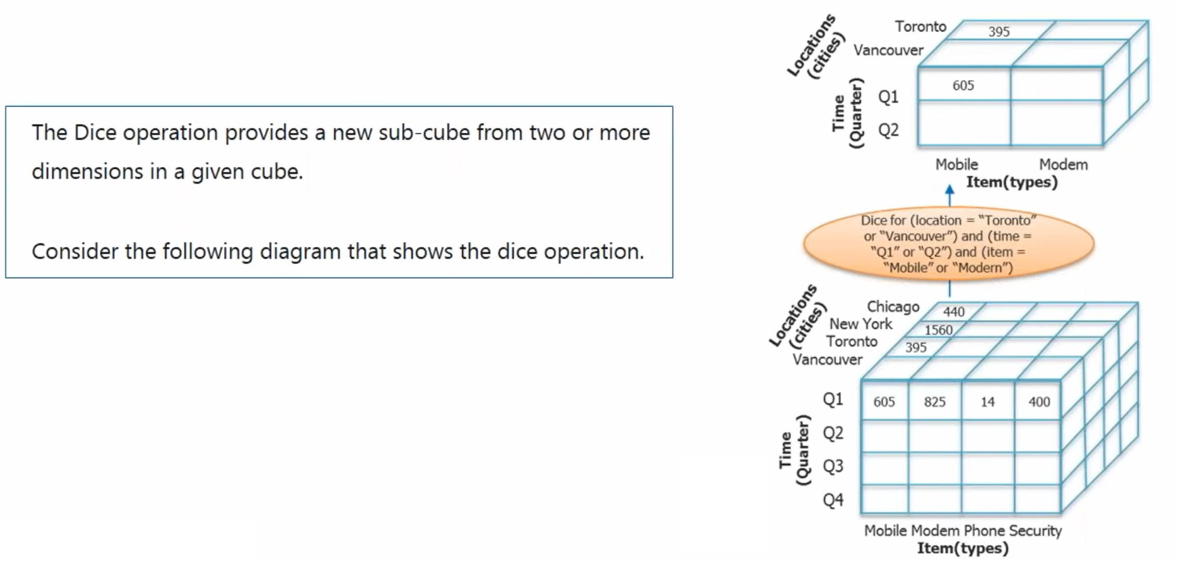
OLAP Operations– Dice

Slide 17
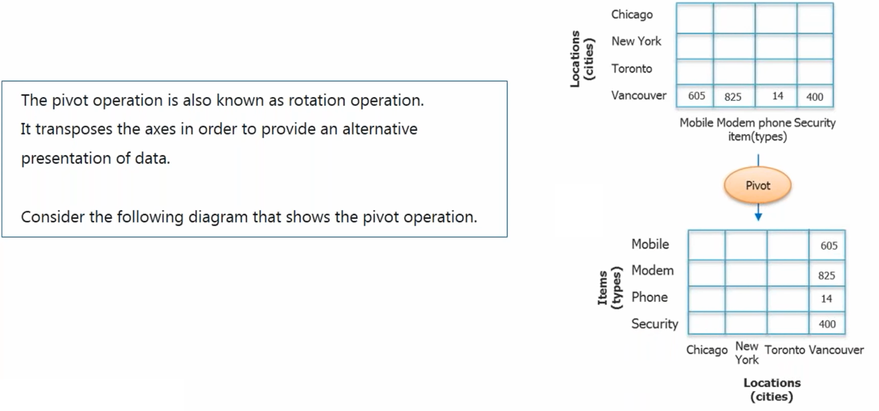
OLAP Operations– Pivot

Slide 18
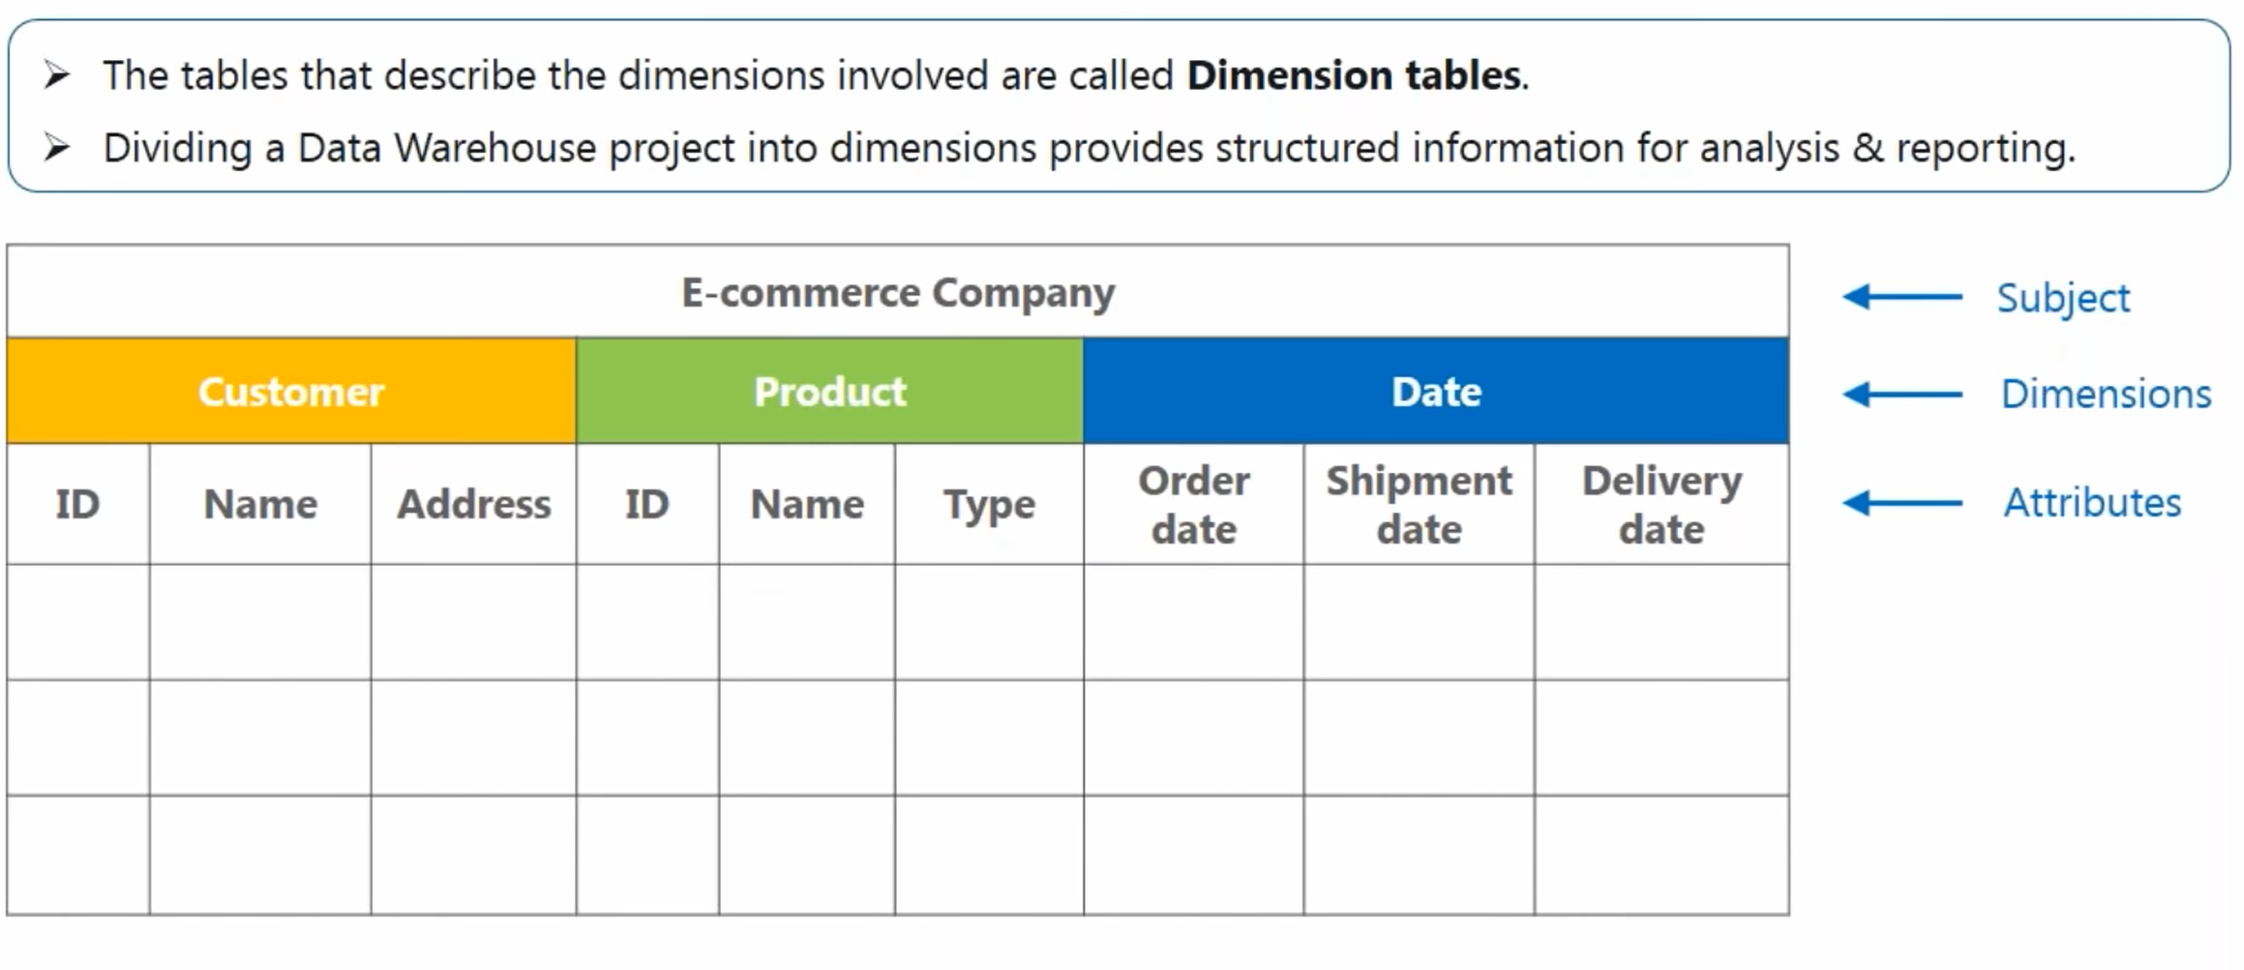
Dimensions

Slide 19
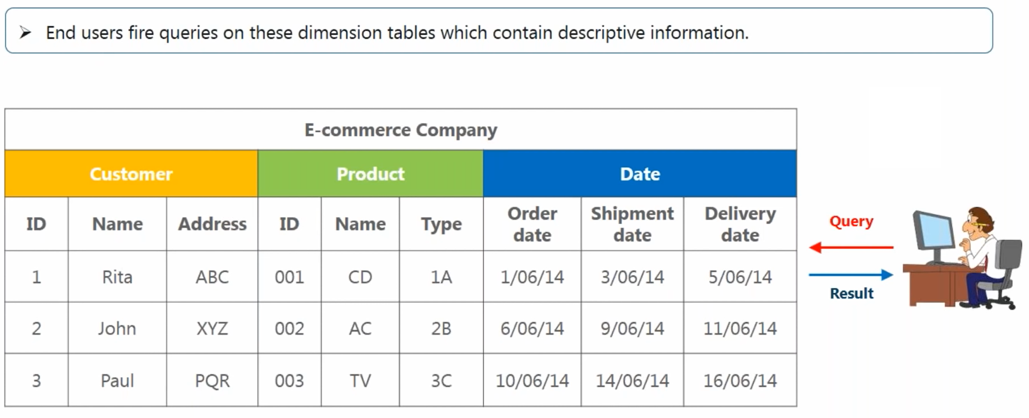
Dimensions

Slide 20
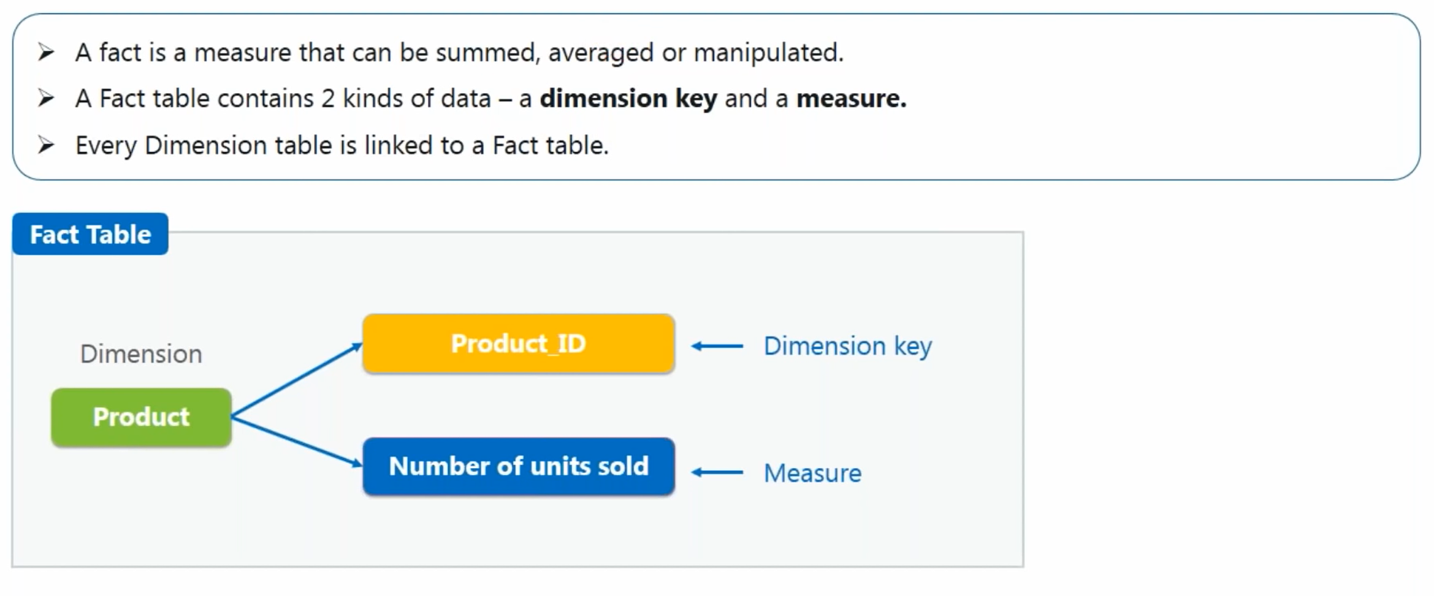
Facts & Measures

Slide 21
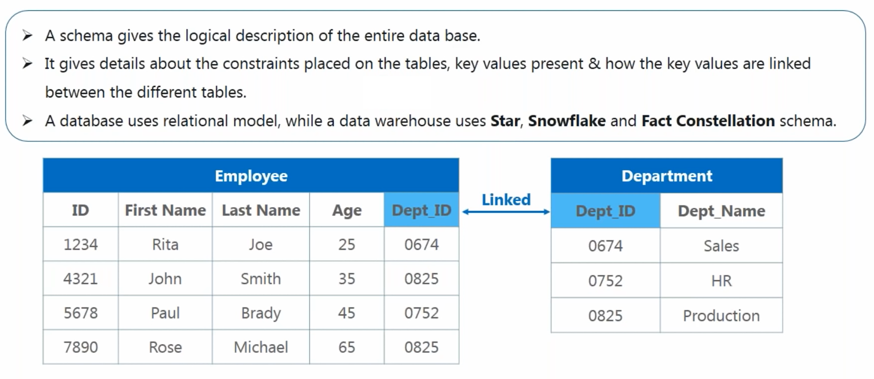
Schemas

Slide 22
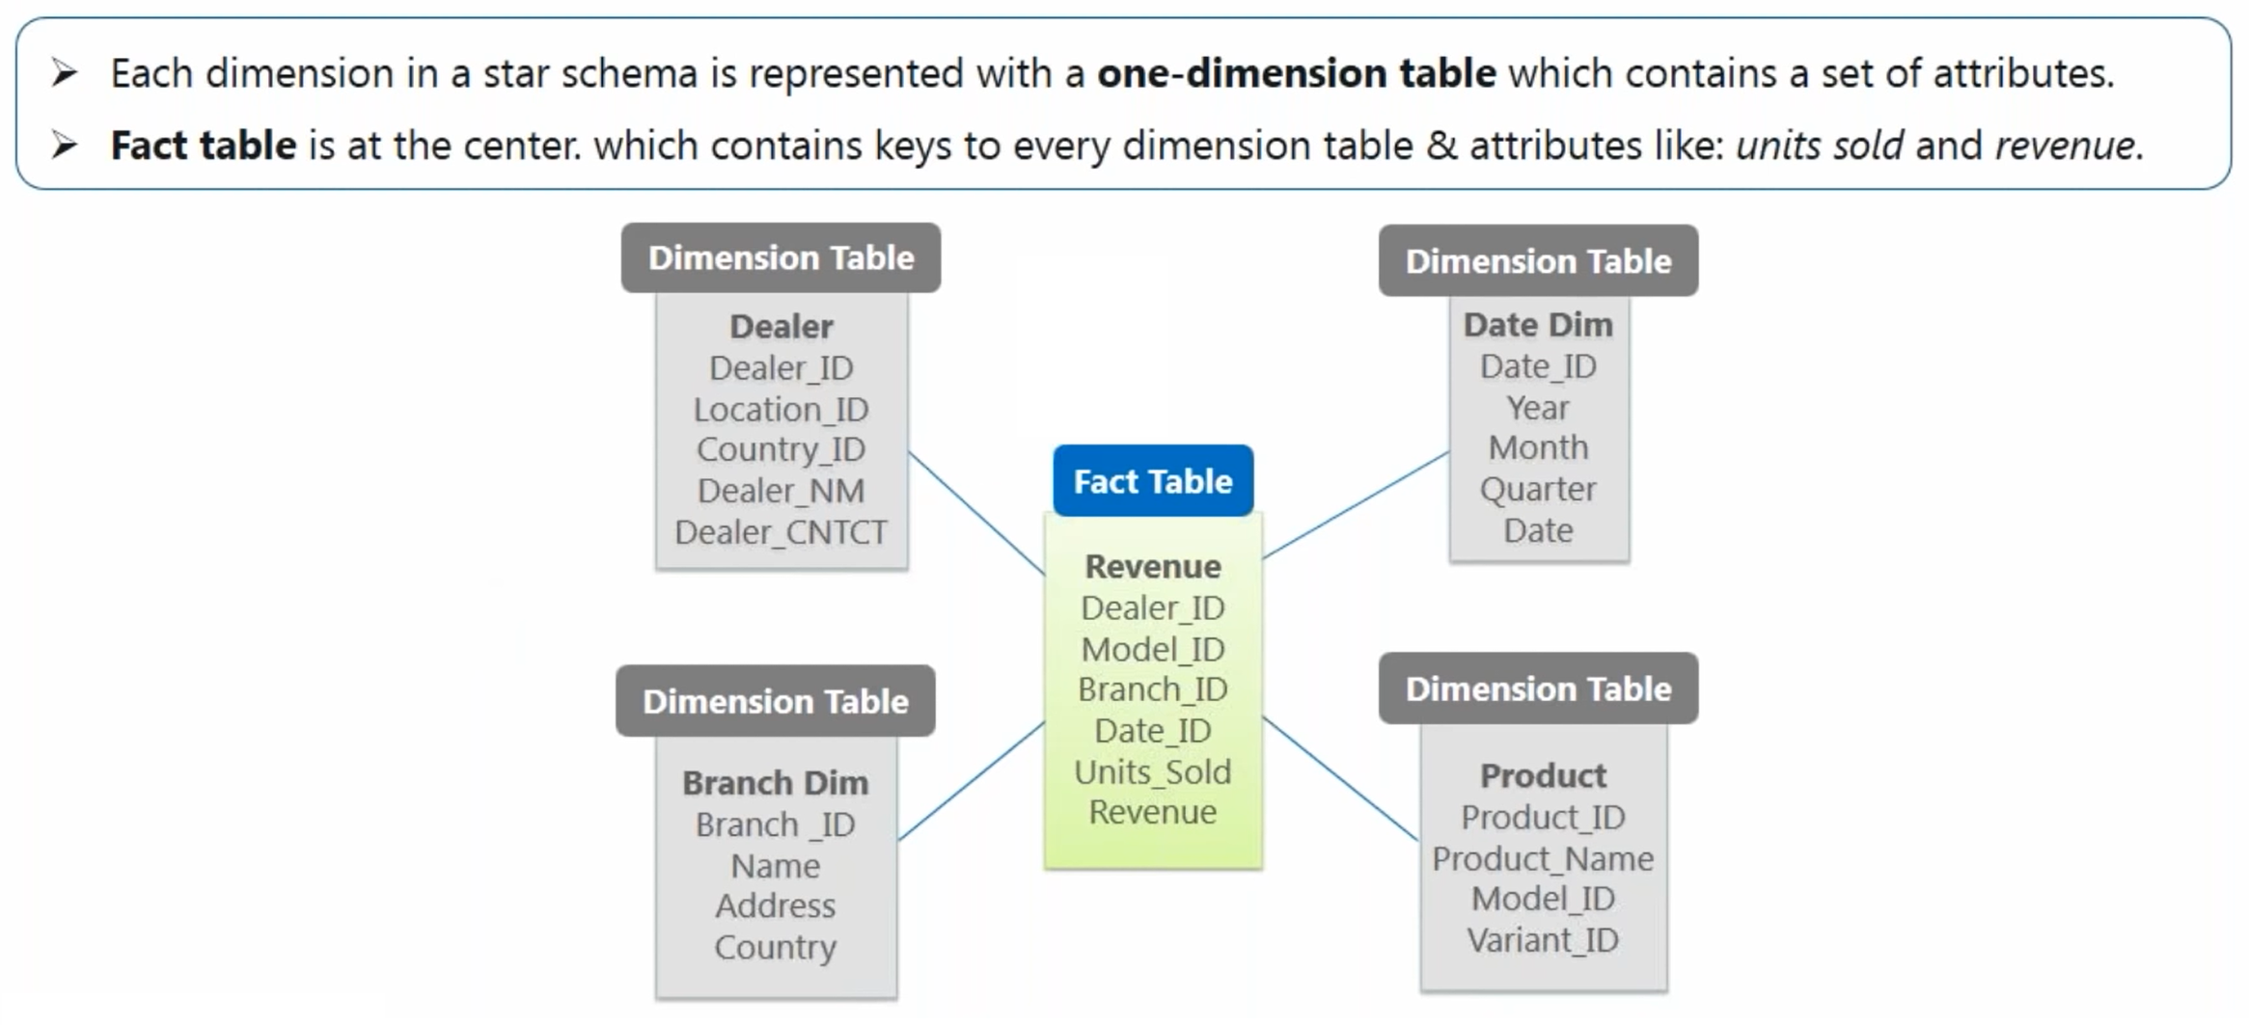
Star Schema

Slide 23
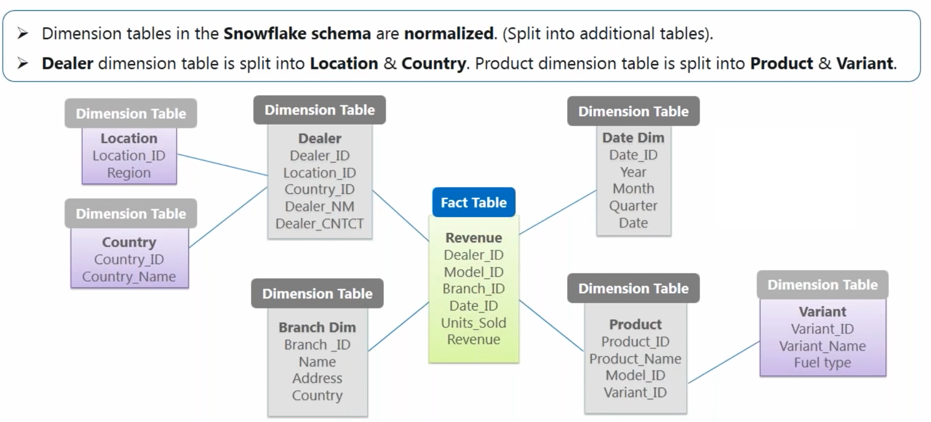
Snowflake Schema

Slide 24
DATA MODELLING

